Slide 1
Guided Capstone Project
Big Mountain Resort

Slide 2
Problem Identification :
Problem Statement- How can we accurately adjust the price of tickets this season to maximize the profits for Big Mountain Resort accounting for facilities provided by them?
Big Mountain Resort, a ski resort located in Montana. The resort's pricing strategy has been to charge a premium above the average price of resorts in its market segment. They are not capitalizing on its facilities as much as it could.Basing their pricing on just the market average does not provide the business with a good sense of how important some facilities are compared to others. This hampers investment strategy.How to select a better value for their ticket price.

Slide 3
Recommendation and key findings
Based on the modeling outcome, we can increase the cost of a ticket by $1.99 by increasing the vertical drop by 150 feet, adding 2 acres of snow making and installing an additional chair lift. Business can use the finding of this model for increasing the profit by $3474638.

Slide 4
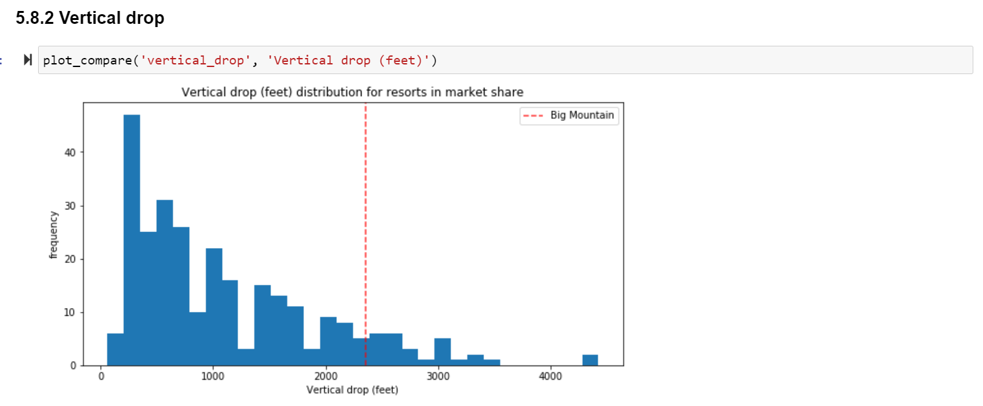
Modeling results and analysis:
Key feature: Vertical Drop
Big Mountain is doing well for vertical drop, but there are still quite a few resorts with a greater drop.
Result: Increasing the vertical drop by 150 feet, supports the price increase by $1.99

Slide 5
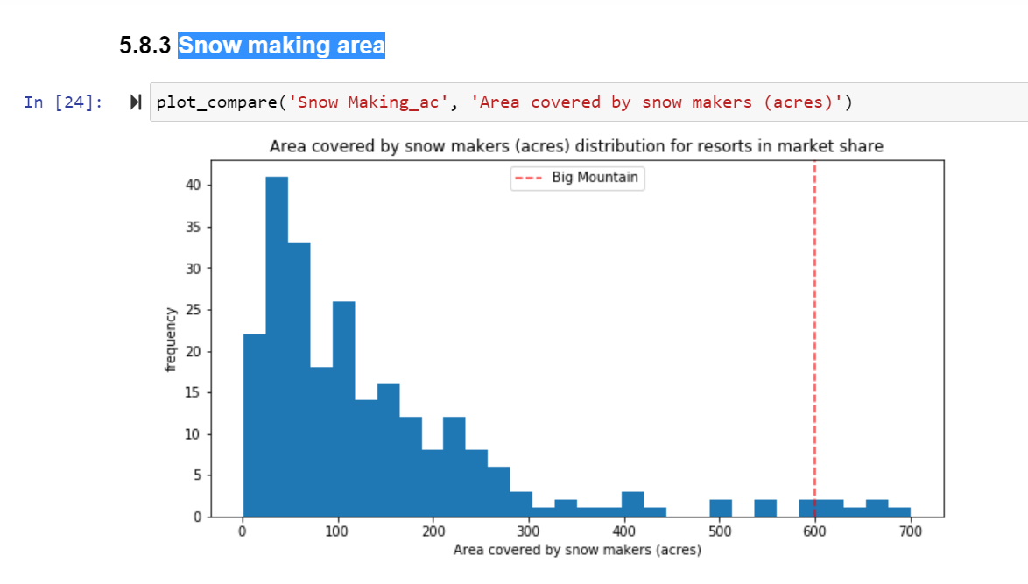
Modeling results and analysis(2)
Key Feature:Snow making area
Big Mountain is very high up the league table of snow making area
Result : adding 2 acres of snow making, supports the price increase by $1.99

Slide 6
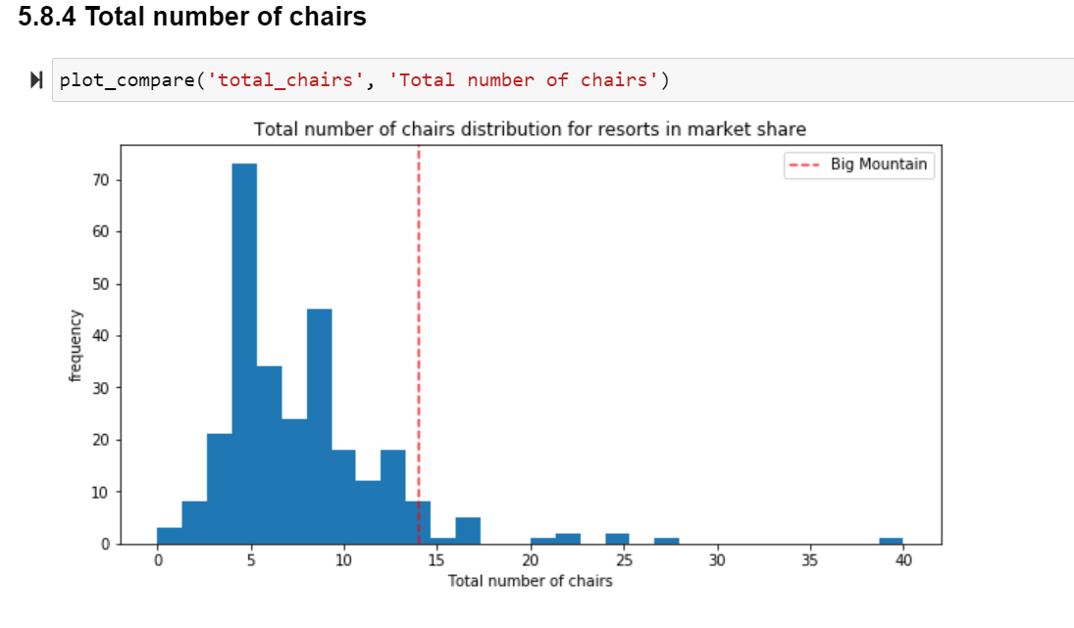
Modeling results and analysis(3)
Key Feature: Chairs
Big Mountain has amongst the highest number of total chairs, resorts with more appear to be outliers.
Result : installing an additional chair lift, supports the price increase by $1.99

Slide 7
Summary and conclusion
Based on the model, we can increase the cost of a ticket by $1.99.
Business can use the finding of this model for increasing the profit by $3474638.

